Slide 1

Microsoft Azure Stack Hub
Azure Stack Hub Automation
This work is licensed under a Creative Commons Attribution - ShareAlike 4.0 International Public License

Slide 2
Agenda
Azure Automation
Automation with Azure Stack Hub
Hybrid automation
Other automation options

Slide 3

Azure Automation
Automation as a service
Think Orchestrator or Azure Pack Service Automation, but in Azure
Automate repetitive or long-running processes
Script authoring environment
Uses PowerShell workflows
Combination of PowerShell 4.0 and WF
Uses integration modules, very similar to PowerShell Modules
Scheduling and monitoring
Execute scripts on a schedule
Review execution status on a dashboard

Slide 4
Azure Automation
What?
Orchestrate and automate time consuming repetitive tasks across multiple systems, including systems external to Azure platform
Perform development, testing, deployment, and management of automation resources from within Azure environment. There is no need for on-premises installation and configuration of infrastructure components
How?
Leverages PowerShell workflow
Supports integration modules to connect to Azure and external systems
Overall architecture and design of automation service stems out of SMA (Service Management Automation)

Slide 5
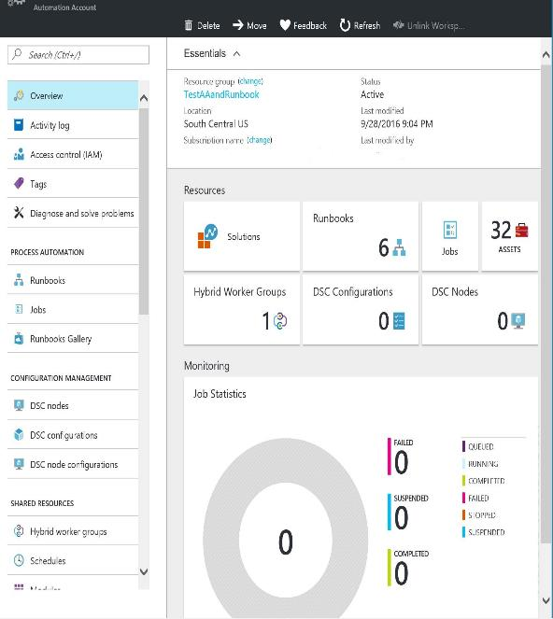
Azure Automation capabilities
Runbook authoring in Azure:
Create runbooks to automate all aspects of cloud operations, from deployment, monitoring, and optimizations
Highly available engine:
Support requirements for scale and H/A
Built on PowerShell workflow. Isolation for runbook jobs
Integration into other systems:
Import PS modules and create additional modules and runbooks for Azure services or to connect into 3rd party systems
Azure Stack Hub
Azure
CMDB
Automation
Monitoring
systems
Backup SQL Azure on a schedule
Patch Azure VMs without downtime
Remediate alert on a service
Staged deployment of a service
Billing
Change
control
systems
Ticketing
Anything ☺

Slide 6
Azure Automation in Azure Stack Hub?

Slide 7
Azure Stack Hub automation capabilities
Azure Stack Hub supports automation through the Azure Resource Manager (ARM), REST API and associated automation capabilities
Azure PowerShell, Azure CLI and Desired State Configuration (DSC), native APIs
Automation plays a critical role in Azure Stack Hub!
Workload onboarding
Administrative management
Azure DevOps
Infrastructure as Code
Resources lifecycle management

Slide 8

If you think you will do a task twice, automate it!

Slide 9
Can we use Azure Automation against Azure Stack Hub?

Slide 10
Azure Automation
It is not an Azure Stack Hub service but may be a future capability.
For “connected” Azure Stack Hub implementation running Azure Automation while targeting Azure Stack Hub can be used as an automation pattern in hybrid scenarios. (More detail coming up!)
For “disconnected” Azure Stack Hub implementation Service Management Automation (SMA) can be used as an IaaS workload to host runbooks.

Slide 11


Azure Automation
Author
Automate operational
tasks
Achieve
on-demand delivery
Integrate
Operate
Automation
Integration
Orchestration
Automation
Optimize and extend existing processes
Deliver flexible and reliable services
Lower costs and improve predictability
Integrate into existing systems with PowerShell integration modules
Extend by building PS modules to enable integrating into other systems
Accelerate time to value with flexible process workflows
Improve service reliability across multiple tools, systems, and department silos
Enable operations to focus on work that adds business value
Reduce error-prone manual activities while lowering costs

Slide 12
Typical automation scenarios
Patch/update/backup orchestration
Patch Azure IaaS VMs without downtime, leveraging Traffic Manager
Enable regeneration of storage account keys while avoiding downtime in the application
SQL backup on a schedule
Backup and restore IaaS VMs
Change control and provisioning
Deploy a VM on an Azure/on-premises cloud and enable monitoring for the VM
Deploy a new service to Azure and configure the end points for CPU and memory alerts
Deploy application from Git, run validation tests, and swap to production if tests pass
Monitor SharePoint online for an approval to update a service and update the service once approved
Monitoring and remediation
Alert on a VM then turn on tracing, collect logs, upload to Azure Storage, and make available in Visual Studio for troubleshooting
Monitor for when a new service gets created, and configure it for the right tracing/backup policy
Notify users of a subscription who have underutilized VMs and perform remediation

Slide 13
Hybrid automation using Azure Automation

Slide 14
Hybrid automation using Azure Automation
What?
Runbooks stored and managed in Azure Automation
Delivered and run against on-premises services including Azure Stack Hub
Why?
Single management solution for all resources: Azure, 3rd party cloud, or on-premises
Removes the need for on-premises management products. E.g., Orchestrator, Service Management Automation, etc.
How?
Runs on Windows Server 2012 and later
Uses Operations Management Suite (OMS), MS Management Agent (MMA) Channel, and Intelligence Pack Solution channel to deliver the runbook

Slide 15
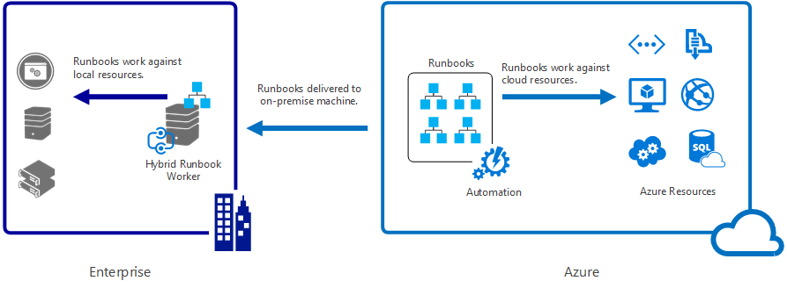
Hybrid Runbook Workers
http://aka.ms/Azure/Automation/Hybrid

Slide 16
Hybrid Runbook Worker notes
Hybrid Runbook Worker groups
Every Hybrid Runbook Worker is part of a group
Define multiple workers for high availability
Modules
Must import modules that integrate with resources
Assets
Can use the cloud assets: variables, credentials, connections, and certs
Scheduling (Jobs) not currently supported. Mitigation is to use a cloud runbook,
schedule it and call Start-AzureRMAutomationRunbook
Permissions
Hybrid Runbooks execute under Local System Account
Must provide your own authentication for non-Azure resources
Use a credential asset and retrieve at runtime using Get-AzureRMAutomationCredential
Read more

Slide 17
Additional fine points
Azure Scheduler
Provides more control over when runbooks run. E.g., on a specific day or in minute increments
Automation WebHooks
Start a runbook in response to an HTTP Request. Read more
Azure Automation DSC
Consistently deploy, reliably monitor, and automatically update the desired state of all your IaaS resources. Read More
Continuous deployment using Chocolatey
Allows you to install packages from a central repository of packages into a Windows system using the command line. Read More

Slide 18
Other Options for Automating IaaS VM Configuration

Slide 19

Tools to automate activities in Azure Stack Hub
Desired State Configuration (DSC)
Custom script extensions
Custom data integration (Linux Workloads)
3rd party tools
Chef
Puppet
Ansible

Slide 20
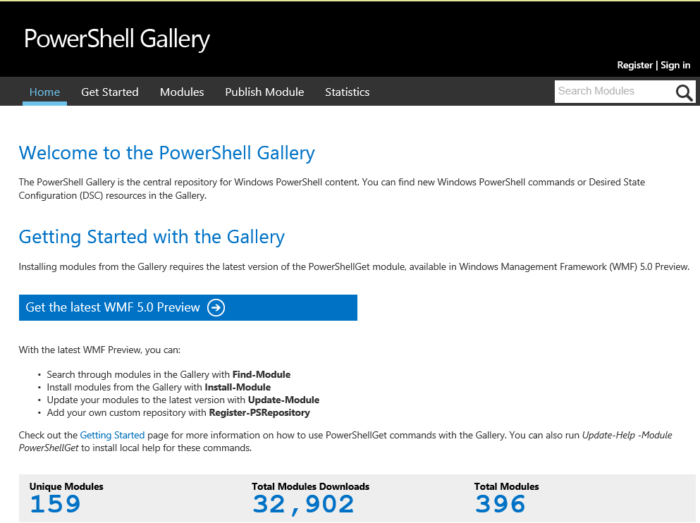
PowerShell Desired State Configuration
Simplifies configuration
Prevents configuration drift
Flexible deployment options
Enables continuous deployment
Modules available from PS Gallery

Slide 21
DSC enables…
Cloud scale
Reduced complexity – all VMs get the same configuration
On-demand system creation and tear down
Configuration as code
Conflict detection – non-conforming systems identified
Single source, multiple environment – can pull from ONE place
DevOps
Apply Dev practices to Operations – Devs can specify DSC policy
Continuous deployment

Slide 22
Extending automation with modules
Configure systems with PowerShell DSC
DSC resource modules enable configuration of your system using the Automation DSC pull service
Integrate into 3rd party systems
Dozens of 1st + 3rd party PowerShell modules exist today
Automation Integration Module = PowerShell Module + one extra optional file
Write your own modules
Write Automation modules for custom solutions
Simply by writing PowerShell modules in C# or PowerShell
Can convert anything with a REST API
Some best practices to make your modules light up in Automation

Slide 23
Azure Automation + DSC
PS DSC pull/reporting service hosted in the cloud
Manage physical hosts and VMs in any cloud or on-premises
Windows or Linux
Part of the Azure Automation service
PS DSC configuration, node configuration, node, and resource management
Import
Authoring
Compiling
Versioning
Distribution to nodes
Reporting
Easy node onboarding

Slide 24
Azure Automation + DSC
Staging
Authoring
MOF
MOF
Configuration
(script)
Node configuration
(MOF)
Reports
checksum
Rest endpoint
DSC
resources
Zip
Zip
Zip
Azure
Automation
Azure VM
Physical server
Azure Stack Hub
VM
On-premises
VM

Slide 25
DSC and runbooks – Better together
Use PS DSC to declaratively configure VMs/physical hosts
Use runbooks to orchestrate complex processes across systems
Use PS DSC within Azure Automation runbooks to configure machines as part of larger processes
Ex: The multi-step process of deploying new DSC configurations to production servers:
Monitor source control for new commits to DSC repository of an organization
When new commit, store the DSC in Azure Automation DSC, set up to be pulled by the stage environment VMs
Run test suite to confirm service in stage environment is functioning properly
If tests fail, alert developers
If tests pass, wait for maintenance window and then set up the DSC in Azure Automation to be pulled by production VMs, in a way that maintains service availability

Slide 26
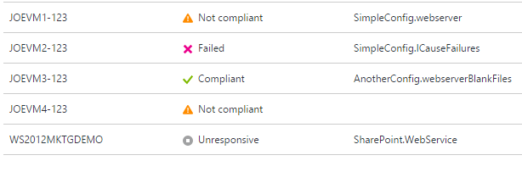
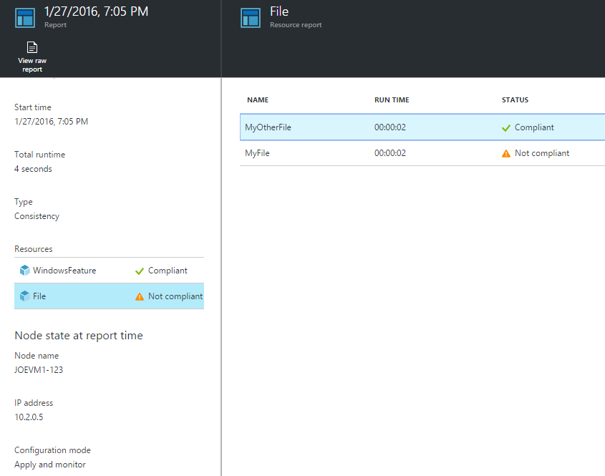
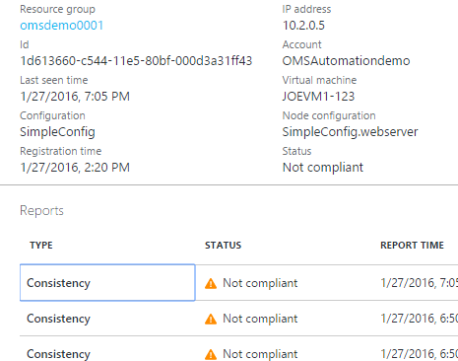
Azure Automation DSC
Reporting
Compliance status
Improved reporting
Support for report-only endpoint

Slide 27
DSC push model
“Make it So” Phase
(Declarative configuration is reified through imperative providers)
Staging Phase
Fully declarative configuration representation using DMTF standard MOF instances
Configuration is calculated for all nodes
Authoring Phase
(May include imperative as well as declarative code)
Local configuration store
PowerShell
Configuration Staging Area
(Contains DSC data)
Pull Server
(Contains DSC data and modules)
Parser and dispatcher
3rd party languages and tools
Resources
DSC Pull Model
When authoring in PowerShell:
Declarative syntax extensions
Schema-driven Intellisense
Schema validation (early-binding)
Resources implement changes:
Monotonic
Imperative
Idempotent

Slide 28
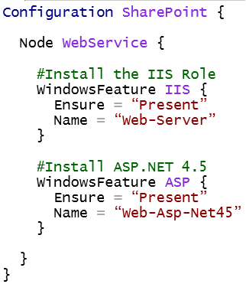

DSC terms and processes
Configuration scripts:
Node Configurations
(.MOF config document)
Nodes
Compiled
Applied to:
via push
or pull
1…N per
configuration script
1…N per
node configuration
1…N

Slide 29
Questions?

